Slide 1
EASIcab Kick-off Meeting
PRESENTED In house
Date : 29th July 2016

Slide 2
AGENDA
Customer profile
Project Scope
Project Overview
Development approach
Block Diagram
Customer requirements
Project Flow Diagram
Customer supplied material
Project Execution approach
Project plan
Resource plan [Hardware / Software / People etc.]
Communication plan
Quality requirements
Assumptions
Risk Management
Change Management
Project Deliverables
How to use & How it will work

Slide 3
Customer Profile
Name: EASi engineering Travel Desk
Location: India
Overview about customer products / business:
EASi provides critical, innovative engineering solutions around the globe for customer as well as employees.
EASi Cab management system plays a vital role for employee in point of safe & secure transportation.

Slide 4
Project Scope
Simple and easy smart phone application to monitor and manage the EASi cab facilities
Easily manage the cab facilities by smartphones
The project entails:
Develop smartphone applications(android) for easy and safety management
Web Service development for the whole app module
Integrate the application with web services

Slide 5

Project Overview

Slide 6
Development Approach
Phase 1:
Static flow between all screens in android application.
UI for three different role ( Admin, Driver, Employee) with supporting multiple screen sizes
Simple Google map integration with current location.
Phase 2.1:
Log in, Registration, settings and Check-in and Check-out functionalities
Cab monitoring & Google map
Call and SMS service
SOS (Emergency Button)
Web service Integration in the application
Export reports in excel format
Phase 2.2:
Voice recognition module
Note: It’s a separate module , If success it can be combined in the application

Slide 7
Development Approach
Phase 3:
Tracking with real GPS device.
Notification
Publishing the application to cloud

Slide 8
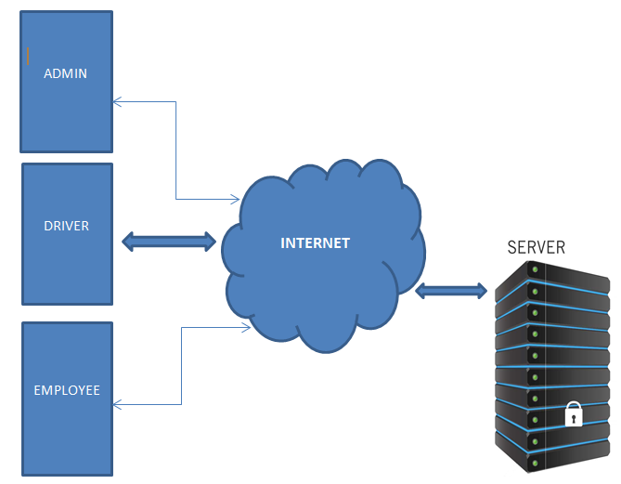
Block diagram

Slide 9
Customer Requirements
UI :
UI for different role based app modules e.g. Driver, Employee and Admin for smartphone supporting all screen sizes
Functionalities :
UI for three different role ( Admin, Driver, Employee) with supporting multiple screen sizes
Log in, Registration, settings and Check-in and Check-out functionalities
Cab monitoring & Google map
Call and SMS service
SOS (Emergency Button)
Web service Integration in the application
Export reports in excel format

Slide 10
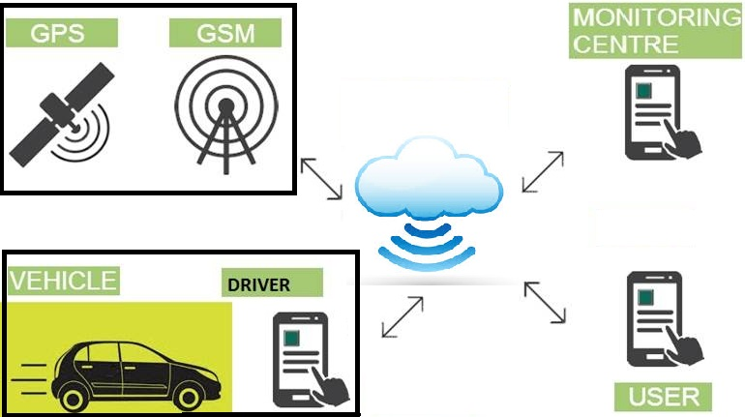
Project Flow

Slide 11
Customer Supplied Material
Provided :
Android & iOS devices for testing
Credential for SVN
Requirement document
Request to provide :
iOS developer credentials
R&D required :
Web services in java
Voice recognition module

Slide 12
Project Execution Approach
Planning
Execution
Review and approval
Acceptance & Closure
Requirement gathering
Create UI/UX design flow & document
Create effort estimation of version 1 & 2
Create and submit Project Proposal
Study of requirements spec
Code development
Manual test plan for new functionality
Perform static analysis of code
Create Checklist for internal review
Create user manual guide
Create Review log for all files
Internal review and approval of all work products
Project acceptance signoff

Slide 13
Project Plan
Milestone | Date
Project Kick-off (Internal) | 29-july-2016
Project Kick-off
Project start date
User manual
Code development | On-going through the project execution phase
Review | On-going through the project execution phase
Test Report | On-going through the project execution phase

Slide 14
Resource Plan [Software / Hardware / People]
Tool & Software :
Android Studio – Android Development
X-code – iOS Development
Eclipse, Apache
Tomcat Server &
MySQL Database – Web Service Development
SVN -- Source control
Simulator – For application Testing
Testing Tool- Bugzilla
Programming Languages :
Java (Web Service & Android)
Swift (iOS)
Hardware
Android devices
iOS devices
Resource
Android Developer engineer – Subhalaxmi, Nitesh
iOS Developer engineer - Rohit

Slide 15
Communication Plan
Deliverables shall be sent via SVN source control
Weekly status update will be maintained in team.
Queries and responses will be collated on a query tracker and updated to SVN on a daily basis, if any
All status, MOMs and required documents need to be maintained in SVN.

Slide 16
Quality Requirements
Minimum 95% FTR and 90% OTD have to be achieved and all work products shall be stored in SVN
Benchmark target is (+/-) 10%
Internal review of all work products shall take place and be maintained in SVN
Review checklist shall be used for all Internal reviews
Weekly quality metrics shall be maintained and published
All communication in team or with manager will be maintained in SVN

Slide 17
Assumptions
Phase 1 :
We will work on the local database(android preferences) inside mobile till web service is ready
It will be the static flow for basic demo purpose
Phase 2 :
For iOS mobile application, we’ll be using the simulator for debugging, as we don’t have the apple developer membership (account) for profiles and certificates for testing in the real device
Phase 3 :
Publish web service and MySQL Database

Slide 18
Risk Management
Risk Description | Probability of Occurrence | Impact | Mitigation Plan | Contingency Plan
If any Resource is absent due to emergency, it may hamper the deliverables | Medium | Medium | NA | Extra effort need to put or. Internal Training/KT in team so that buffer resource can be used.
iOS developer account | Medium | High | We will test in simulator. | Try to apply it in later version.

Slide 19
Change Management
Any functionality or activities that are not specifically mentioned in the scope are considered excluded from the scope of this proposal. If EasiCab so requires, such functionalities or activities can be considered as a change of scope and routed through EASi’s Change Management Process as illustrated.

Slide 20
Change Management
Register CR in CR Log with CR Priority and Status: Open
Perform CR Impact Analysis
Estimate effort and cost
Estimate impact on schedule, if any
Check for additional specifications, if required
Receive Change Request (CR)
Communicate CR Impact to Customer
Estimate effort and cost
Estimate impact on schedule, if any
Request additional specifications, if required
Update Impacted activity and work products (including Specifications, if any)
Communicate to CR Stakeholders
Seek Approval from Customer CRequestor
Yes
Execute Change Request
Log the CR activity as a New Task
Update the necessary revision details / attributes for the impacted change and functionality
No
Update CR Log with CR Status: Closed
Update CR Log with CR Status: Dropped
Amend SOW / PO to Incorporate CR

Slide 21
Project Deliverables
Working Code (UI/Functionalities)
.apk file of android
.ipa file of iOS
User manual
Note: All project reports, documents and source code will available in SVN Path:
https://asi-storage07.blr.allegisindia.com/svn/EASi_App-POC/

Slide 22
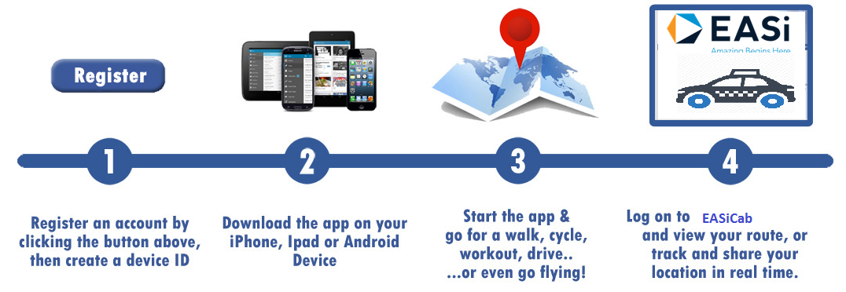
How to use

Slide 23
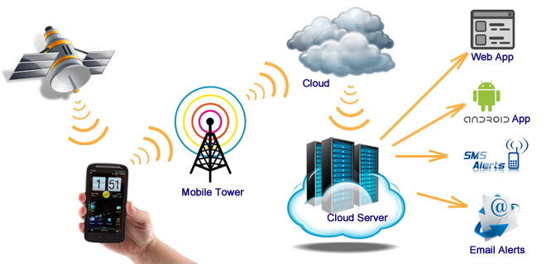
How it will work..

Slide 24
Thank you
For more details, please contact:
EASi Embedded
Bangalore

